Slide 1
EITF75 Systems and Signals
Lecture 2
LTI systems: convolutions, impulse responses (and more)
Fredrik Rusek

Slide 2
EITF75 Systems and Signals
LTI systems
A system is LTI if-and-only if:
system
It is linear
It is time-invariant
Linear system
Time invariant system

Slide 3
EITF75 Systems and Signals
LTI systems
Today we will show that these are equivalent
LTI
For some h(k)
For some a(k), b(k)

Slide 4
EITF75 Systems and Signals
LTI systems
Today we will show that these are equivalent
LTI
We start here
Alt method at the end
For some h(k)
For some a(k), b(k)

Slide 5
EITF75 Systems and Signals
A system is LTI if-and-only if:
LTI
system
It is linear
It is time-invariant
Input signal
Output signal

Slide 6
EITF75 Systems and Signals
Summary
LTI
Input/Output relation
(Convolution)
Short-hand notation

Slide 7
EITF75 Systems and Signals
Agenda
Next (Today)
Get familiar with through some examples
For what do we have BIBO stability?
Prove equivalence between and
Some notes on correlation functions
In the long run (Loosely speaking)
Study in detail via z-transform, and 2 types of Fourier transforms
The sampling-reconstruction issues

Slide 8
EITF75 Systems and Signals
Example
Given: Input signal and impulse response
Find: Output signal
”Home work 1”
Verify that causal x(n) and causal
h(n) yields causal y(n)
”Home work 2”
If x(n) starts at -3, and h(n) at -4.
When does y(n) start?
”Home work 3”
etc

Slide 9
EITF75 Systems and Signals
Example
Three more methods
Method 1
Given: Input signal and impulse response
Find: Output signal

Slide 10
EITF75 Systems and Signals
Example
Three more methods
Method 1
Given: Input signal and impulse response
Find: Output signal

Slide 11
EITF75 Systems and Signals
Example
Three more methods
Method 1
Given: Input signal and impulse response
Find: Output signal

Slide 12
EITF75 Systems and Signals
Example
Three more methods
Method 1
Given: Input signal and impulse response
Find: Output signal

Slide 13
EITF75 Systems and Signals
Example
Three more methods
Method 1
Given: Input signal and impulse response
Find: Output signal

Slide 14
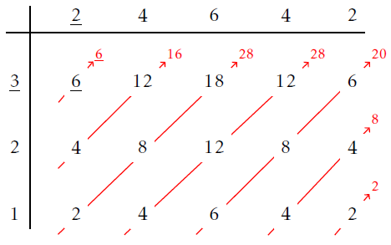
EITF75 Systems and Signals
Example
Three more methods
Method 2
Given: Input signal and impulse response
Put numbers in a table and multiply

Slide 15
EITF75 Systems and Signals
Example
Three more methods
Method 2
Given: Input signal and impulse response
Put numbers in a table and multiply

Slide 16
EITF75 Systems and Signals
Example
Three more methods
Method 2
Given: Input signal and impulse response
Sum the diagonals

Slide 17
EITF75 Systems and Signals
Example
Three more methods
Method 2
Given: Input signal and impulse response
Result

Slide 18
EITF75 Systems and Signals
Make sure that you understand why a convolution
of a length K signal with a length L signal has length K+L-1

Slide 19
EITF75 Systems and Signals
Example
Three more methods
Method 3: Analytical solution

Slide 20
EITF75 Systems and Signals
Standard Properties
Commutativity
Associativity
Distributivity

Slide 21
EITF75 Systems and Signals
Commutativity
Associativity
Distributivity
Some consequences

Slide 22
EITF75 Systems and Signals
Commutativity
Associativity
Distributivity
Some consequences

Slide 23
EITF75 Systems and Signals
Commutativity
Associativity
Distributivity
Some consequences

Slide 24
EITF75 Systems and Signals
BIBO stability
A system is BIBO stable if

Slide 25
EITF75 Systems and Signals
LTI systems
Today we will show that these are equivalent
LTI
For some h(k)
We now show this
For some a(k), b(k)

Slide 26
EITF75 Systems and Signals
Relation to difference equations

Slide 27
EITF75 Systems and Signals
Relation to difference equations
Consider now
We then get

Slide 28
EITF75 Systems and Signals
Relation to difference equations
Consider now
We then get
Pattern recognition, suitably done at home, gives

Slide 29
EITF75 Systems and Signals
Summary
AN LTI SYSTEM ”A” is equivalent to
A CONVOLUTION WITH IMPULSE RESPONSE ”h(n)” which is equivalent to
A RECURSION EQUATION WITH COEFFICIENTS ”a(k), b(k)”
LTI

Slide 30
EITF75 Systems and Signals
Brief info on correlation
Not focal point of course, but highly important in signal processing
Correlation measures similarity between two signals

Slide 31
EITF75 Systems and Signals
Brief info on correlation
Not focal point of course, but highly important in signal processing
Correlation measures similarity between two signals
Auto correlation
Cross correlation
Measures similarity between time shifted
versions of the same signal
Measures similarity between time shifted
versions of different signals

Slide 32
EITF75 Systems and Signals
Brief info on correlation
Not focal point of course, but highly important in signal processing
Correlation measures similarity between two signals
Auto correlation
Cross correlation
Measures similarity between time shifted
versions of the same signal
Measures similarity between time shifted
versions of different signals
Example: 5G communication system
When a user (UE) wants to connect,
it sends a known signal, x₁(n) or x₂(n)
x₁(n)
UE1
BS
Transmitters
Receiver
UE2
x₂(n)

Slide 33
EITF75 Systems and Signals
Brief info on correlation
Not focal point of course, but highly important in signal processing
Correlation measures similarity between two signals
Auto correlation
Cross correlation
Measures similarity between time shifted
versions of the same signal
Measures similarity between time shifted
versions of different signals
Example: 5G communication system
When a user (UE) wants to connect,
it sends a known signal, x₁(n) or x₂(n)
x₁(n)
UE1
BS
Receiver
UE2
x₂(n)
Cross correlation between x₁(n) and x₂(n) should be small (to know who is connecting)

Slide 34
EITF75 Systems and Signals
Brief info on correlation
Not focal point of course, but highly important in signal processing
Correlation measures similarity between two signals
Auto correlation
Cross correlation
Measures similarity between time shifted
versions of the same signal
Measures similarity between time shifted
versions of different signals
Example: 5G communication system
When a user (UE) wants to connect,
it sends a known signal, x₁(n) or x₂(n)
x₁(n)
UE1
BS
Receiver
UE2
x₂(n)
Auto correlation of x₁(n) (and x₂(n)) should be delta (to know when a user is connecting)

Slide 35
EITF75 Systems and Signals
Brief info on correlation
Cross correlation for input and output signals

Slide 36
Appendix
A system is LTI if-and-only if:
LTI
system
It is linear
It is time-invariant
Method II (not in book, but I find it illuminating)
Input x(n): A sequence of numbers
Output y(n): A sequence of numbers
In the Linear algebra course, how did we represent a sequence of numbers?

Slide 37
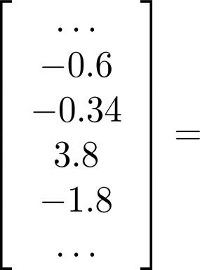
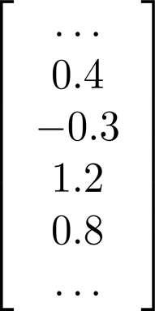
EITF75 Systems and Signals
A system is LTI if-and-only if:
LTI
system
It is linear
It is time-invariant
Method II (not in book, but I find it illuminating)
Input x(n): A sequence of numbers
Output y(n): A sequence of numbers
In the Linear algebra course, how did we
represent a sequence of numbers? With a vector
OUT
IN

Slide 38
EITF75 Systems and Signals
A system is LTI if-and-only if:
LTI
system
It is linear
It is time-invariant
Method II (not in book, but I find it illuminating)
Input x(n): A sequence of numbers
Output y(n): A sequence of numbers
In the Linear algebra course, how did we
represent a sequence of numbers? With a vector
OUT
IN
Why is the linear algebra course dealing so much with matrices?

Slide 39
EITF75 Systems and Signals
A system is LTI if-and-only if:
LTI
system
It is linear
It is time-invariant
Method II (not in book, but I find it illuminating)
Input x(n): A sequence of numbers
Output y(n): A sequence of numbers
In the Linear algebra course, how did we
represent a sequence of numbers? With a vector
OUT
IN
Why is the linear algebra course dealing so much with matrices?
Because every linear function can be represented by a matrix

Slide 40
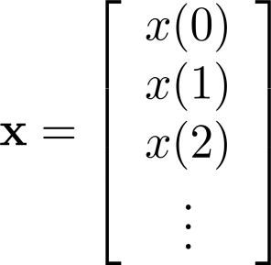
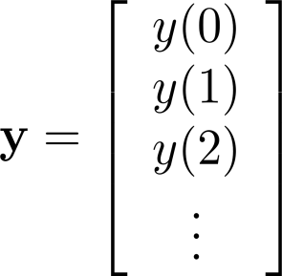
EITF75 Systems and Signals
A system is LTI if-and-only if:
LTI
system
It is linear
It is time-invariant
Method II (not in book, but I find it illuminating)
Summary so far: A linear system can be represented as
where

Slide 41
EITF75 Systems and Signals
A system is LTI if-and-only if:
LTI
system
It is linear
It is time-invariant
Method II (not in book, but I find it illuminating)
A linear system can be represented as
where
But, our system is LTI, not only linear,
so this imposes restrictions on
i.e., must have a special structure

Slide 42
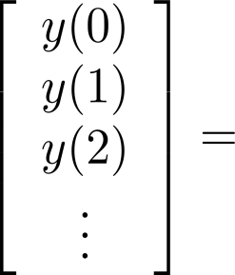
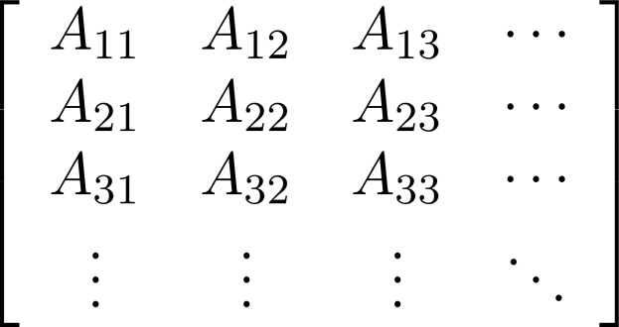
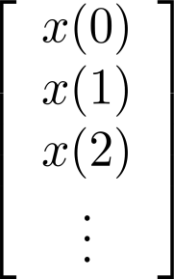
EITF75 Systems and Signals
A system is LTI if-and-only if:
LTI
system
It is linear
It is time-invariant
Method II (not in book, but I find it illuminating)
A linear system can be represented as
Let us understand this special structure

Slide 43
EITF75 Systems and Signals
A system is LTI if-and-only if:
LTI
system
It is linear
It is time-invariant
Method II (not in book, but I find it illuminating)
A linear system can be represented as
Assume
Let us understand this special structure

Slide 44
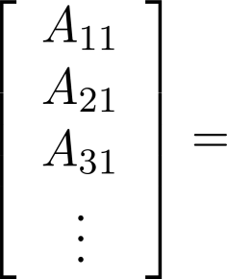
EITF75 Systems and Signals
A system is LTI if-and-only if:
LTI
system
It is linear
It is time-invariant
Method II (not in book, but I find it illuminating)
A linear system can be represented as
Assume
The output must be
the first column of
Let us understand this special structure

Slide 45
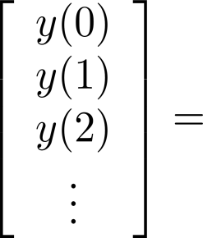
EITF75 Systems and Signals
A system is LTI if-and-only if:
LTI
system
It is linear
It is time-invariant
Method II (not in book, but I find it illuminating)
A linear system can be represented as
Assume
Let us understand this special structure

Slide 46
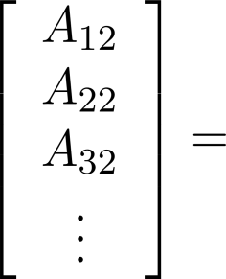
EITF75 Systems and Signals
A system is LTI if-and-only if:
LTI
system
It is linear
It is time-invariant
Method II (not in book, but I find it illuminating)
A linear system can be represented as
Assume
The output must be
the second column of
Let us understand this special structure

Slide 47
EITF75 Systems and Signals
A system is LTI if-and-only if:
LTI
system
It is linear
It is time-invariant
Method II (not in book, but I find it illuminating)
Now recall that system
is time-invariant
Implication?

Slide 48
EITF75 Systems and Signals
A system is LTI if-and-only if:
LTI
system
It is linear
It is time-invariant
Method II (not in book, but I find it illuminating)
Now recall that system
is time-invariant
Implication?
The outputs should be
The same, but one step
delayed

Slide 49
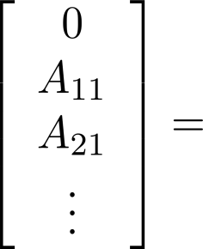
EITF75 Systems and Signals
A system is LTI if-and-only if:
LTI
system
It is linear
It is time-invariant
Method II (not in book, but I find it illuminating)
Now recall that system
is time-invariant
Implication?
The outputs should be
The same, but one step
delayed
i.e.

Slide 50
EITF75 Systems and Signals
A system is LTI if-and-only if:
LTI
system
It is linear
It is time-invariant
Method II (not in book, but I find it illuminating)
Now recall that system
is time-invariant
Implication?
The outputs should be
The same, but one step
delayed
i.e. equal values along
all diagonals

Slide 51
EITF75 Systems and Signals
A system is LTI if-and-only if:
LTI
system
It is linear
It is time-invariant
Method II (not in book, but I find it illuminating)
Summary. An LTI system is any discrete-time
system that can be described by
Some vector
Same vector
Same vector
Same vector
Same vector
Same vector

Slide 52
EITF75 Systems and Signals
A system is LTI if-and-only if:
LTI
system
It is linear
It is time-invariant
Method II (not in book, but I find it illuminating)
Summary. An LTI system is any discrete-time
system that can be described by
Alternative formulation
of course-goal:
Understand properties of
a matrix of the form
Some vector
Some vector
Same vector
Same vector
Same vector
Same vector
Same vector
Same vector
Same vector
Same vector
Same vector
Same vector

Slide 53
EITF75 Systems and Signals
LTI
system
The LTI system is FULLY characterized
by one vector/sequence of numbers/discrete signal
Some vector
Same vector
Same vector
Same vector
Same vector
Same vector

