Slide 1
EITF75 Systems and Signals
Lecture 1
Introduction
Fredrik Rusek

Slide 2
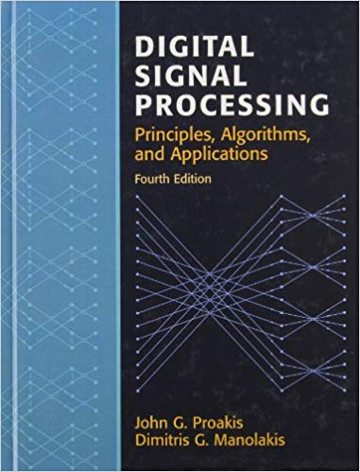
EITF75 Systems and Signals
Schedule:
Lectures, F. Rusek, E:2377
12 lectures, 2/week
1 old exam solving
1 reserve
Exercises, G. Tian (E:2367), A. Sheikhi (E:2366)
14 exercises, 2/week
Labs, G. Tian, A. Sheikhi
2 Labs

Slide 3
EITF75 Systems and Signals
Schedule:
Lectures, F. Rusek, E:2377
12 lectures, 2/week
1 old exam solving
1 reserve
Exercises, G. Tian (E:2367), A. Sheikhi (E:2366)
14 exercises, 2/week
Labs, G. Tian, A. Sheikhi
2 Labs
Self-study time
96 hours

Slide 4
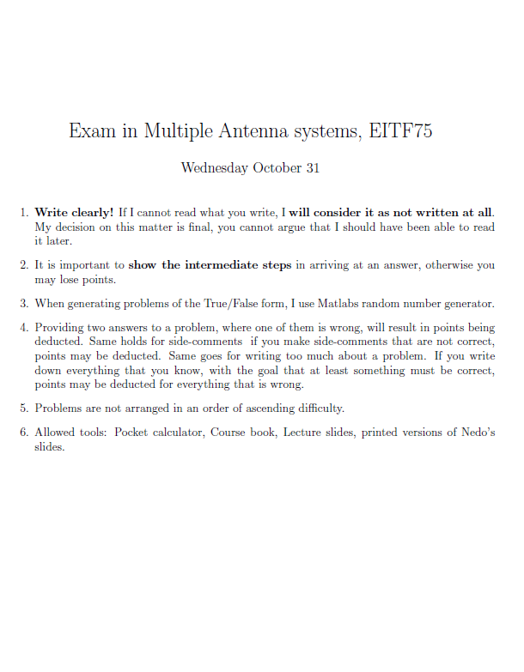
EITF75 Systems and Signals
Allowed tools:
Whatever you want to bring that does not have internet access
Two retake exams:
April, August
Exam gives maximum 5.0 points
Exam in
Systems and signals

Slide 5
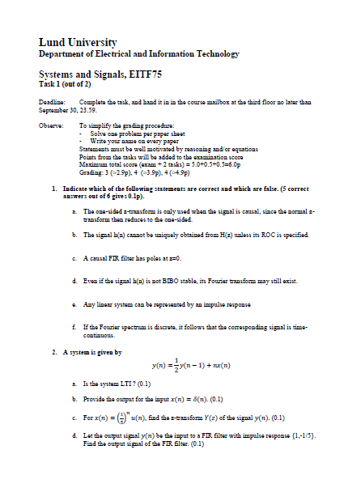
EITF75 Systems and Signals
Allowed tools:
Whatever you want to bring that does not have internet access
Two retake exams:
April, August
Exam gives maximum 5.0 points
There are two hand in assignements, these give 0.5p each
So, total points: 6.0
Hand in assignement
Nbr 1 (of 2)
Grades: 3.0-3.9: 3 4.0-4.9: 4 5.0-6.0: 5

Slide 6
EITF75 Systems and Signals
Allowed tools:
Whatever you want to bring that does not have internet access
Two retake exams:
April, August
Exam gives maximum 5.0 points
There are two hand in assignements, these give 0.5p each
So, total points: 6.0
Hand in assignement
Nbr 1 (of 2)
Points from hand-in assignements valid for 1 year,
i.e., the October, April, and August exams

Slide 7
EITF75 Systems and Signals
Allowed tools:
Whatever you want to bring that does not have internet access
Two retake exams:
April, August
Exam gives maximum 5.0 points
There are two hand in assignements, these give 0.5p each
So, total points: 6.0
Hand in assignement
Nbr 1 (of 2)
Deadline for handing in: end of September, mid-October (see web)

Slide 8
EITF75, Introduction
Continuous time vs. Discrete time
Consider an electronic device, observing a signal
Signal
Device

Slide 9
EITF75, Introduction
Continuous time vs. Discrete time
Consider an electronic device, observing a signal
Signal
Device
In reality, a signal is continuous.

Slide 10
EITF75, Introduction
Continuous time vs. Discrete time
Consider an electronic device, observing a signal
Signal
Device
Output
The device has a task - it should output something

Slide 11
EITF75, Introduction
Continuous time vs. Discrete time
Consider an electronic device, observing a signal
Signal
Output
Device
Most general case is continuous output

Slide 12
EITF75, Introduction
Continuous time vs. Discrete time
Consider an electronic device, observing a signal
Signal
Output
Device
Continuous memory…??
Obvious questions:
How should the device store/represent the signal ?
- Almost impossible…

Slide 13
EITF75, Introduction
Continuous time vs. Discrete time
Consider an electronic device, observing a signal
Signal
Output
Device
Continuous memory…??
Further
Processing
Obvious questions:
Suppose a Fourier transform of is needed.
How to compute for every ?
-Almost impossible…

Slide 14
EITF75, Introduction
Continuous time vs. Discrete time
Consider an electronic device, observing a signal
Signal
Output
Device
Summary
It is very hard for a computer to work with continuous signals
(Think for example of Matlab)

Slide 15
EITF75, Introduction
Discrete time signals
What is the difference between
Continuous signals
Discrete signals
Digital signals
Digital signals:
Continuous signals:
Discrete signals:

Slide 16
EITF75, Introduction
Discrete time signals
What is the difference between
Continuous signals
Discrete signals
Digital signals
Digital signals:
Continuous signals: Simple…
Discrete signals:

Slide 17
EITF75, Introduction
Discrete time signals
What is the difference between
Continuous signals
Discrete signals
Digital signals
Digital signals:
Continuous signals: Simple…
Discrete signals: time is discrete, amplitude is continuous
1
2
3

Slide 18
EITF75, Introduction
Discrete time signals
What is the difference between
Continuous signals
Discrete signals
Digital signals
Digital signals: time is discrete, amplitude is discrete
1
2
3
Continuous signals: Simple…
Discrete signals: time is discrete, amplitude is continuous
1
2
3

Slide 19
EITF75, Introduction
Discrete time signals
What is the difference between
Continuous signals
Discrete signals
Digital signals
Digital signals: time is discrete, amplitude is discrete
1
2
3
Continuous signals: Simple…
Essentially not treated in course.
However, the class of digital signals is a subset of the class of Discrete
signals, so everything we study
applies to digital signals as well
Discrete signals: time is discrete, amplitude is continuous
1
2
3

Slide 20
EITF75, Introduction
Discrete time signals
What is the difference between
Continuous signals
Discrete signals
Digital signals
Where does a discrete signal appear in nature?
Continuous signals: Simple…
Discrete signals: time is discrete, amplitude is continuous
1
2
3

Slide 21
EITF75, Introduction
Discrete time signals
What is the difference between
Continuous signals
Discrete signals
Digital signals
Where does a discrete signal appear in nature?
Nowehere (that I know). All natural signals are continuous/analog.
Discrete signals are man-made.
Examples:
Read temperature at constant interval
Read stock-price once/sec
Read an audio signal 44100 times/sec
Let a cell-phone read an incoming wave 10000000 times/sec
In all cases (except maybe stock price), the underlying signal is continuous, not discrete
Continuous signals: Simple…
Discrete signals: time is discrete, amplitude is continuous
1
2
3

Slide 22
EITF75, Introduction
Discrete time signals
What is the difference between
Continuous signals
Discrete signals
Digital signals
Digital signals: time is discrete, amplitude is discrete
1
2
3
Continuous signals: Simple…
Digital signals come about since it is hard for a computer to store all possible values. So it quantizes them.
We will briefly touch upon the losses involved in quantization
Discrete signals: time is discrete, amplitude is continuous
1
2
3

Slide 23
EITF75, Introduction
Discrete time signals
We study the following system
Signal
Output
Device
sampling
RAM
Processing

Slide 24
EITF75, Introduction
Discrete time signals
We study the following system
Output can be either discrete or continuous
Signal
Output
Device
sampling
RAM
Processing

Slide 25
EITF75, Introduction
Discrete time signals
We study the following system
Output can be either discrete or continuous
Signal
Output
Device
sampling
RAM
Processing
Reconstruction

Slide 26
EITF75, Introduction
Discrete time signals
We study the following system
Output can be either discrete or continuous
Signal
Output
Device
sampling
RAM
Processing
Reconstruction
The target is to carry out the same task as an anolog device would
Signal
Output
Device
Continuous RAM
Processing

Slide 27
EITF75, Introduction
Discrete time signals
We study the following system
Output can be either discrete or continuous
Signal
Output
Device
sampling
RAM
Processing
Reconstruction
The target is to carry out the same task as an anolog device would
Signal
Output
Device
Example: ”The output should be the mean of the input during the last 8 second plus the mean outputs during the last 5 seconds”

Slide 28
EITF75, Introduction
Discrete time signals
We study the following system
Output can be either discrete or continuous
Signal
Output
Device
sampling
RAM
Processing
Reconstruction
Thus, we need to understand how
Sampling should be done so that nothing is lost
How to process a discrete signal
How to convert a discrete signal into a continuous one so that it behaves well
Example: ”The output should be the mean of the input during the last 8 second plus the mean outputs during the last 5 seconds”

Slide 29
EITF75, Introduction
Discrete time signals
We study the following system
Output can be either discrete or continuous
Signal
Output
Device
sampling
RAM
Processing
Reconstruction
Chapters
1 Introduction
2 Discrete-Time Signals And Systems
3 The Z-Transform And Its Application To The Analysis Of LTI Systems
4 Frequency Analysis Of Signals And Systems
5 Frequency Domain Analysis Of Lti Systems
6 Sampling And Reconstruction Of Signals
7 The Discrete Fourier Transform: Its Properties And Applications
8 Efficient Computation Of The DFT: Fast Fourier Transform Algorithms
9 Implementation Of Discrete-Time Systems

Slide 30
EITF75, Introduction
Discrete time signals
We study the following system
Output can be either discrete or continuous
Signal
Output
Device
sampling
RAM
Processing
Reconstruction
Chapters
1 Introduction
2 Discrete-Time Signals And Systems
3 The Z-Transform And Its Application To The Analysis Of LTI Systems
4 Frequency Analysis Of Signals And Systems
5 Frequency Domain Analysis Of Lti Systems
6 Sampling And Reconstruction Of Signals
7 The Discrete Fourier Transform: Its Properties And Applications
8 Efficient Computation Of The DFT: Fast Fourier Transform Algorithms
9 Implementation Of Discrete-Time Systems

Slide 31
EITF75, Introduction
Some recap, notation and other basics
How we express a discrete signal
1
0.5
The bar below ”0” marks that this is at time n=0
1
2
3

Slide 32
EITF75, Introduction
Some notation and basics
Some recap, notation and other basics
How we express a discrete signal
1
0.5
The bar below ”0” marks that this is at time n=0
1
2
3
Examples of systems
system
Easily understood as average of 5 last samples

Slide 33
EITF75, Introduction
Some notation and basics
Some recap, notation and other basics
How we express a discrete signal
1
0.5
The bar below ”0” marks that this is at time n=0
1
2
3
Examples of systems
system
Easily understood as average of 5 last samples
But what does this system do? We’ll understand how to find out…

Slide 34
EITF75, Introduction
Some notation and basics
Some recap, notation and other basics
How we express a discrete signal
1
0.5
The bar below ”0” marks that this is at time n=0
1
2
3
Examples of systems
Important class:
Feedback systems
system
Easily understood as average of 5 last samples
Delay
0.9
But what does this system do? We’ll understand how to find out…
What will happen ?

Slide 35
EITF75, Introduction
Some notation and basics
Some recap, notation and other basics
Some important discrete signals and concepts
Impulse
1
0.5
1
2
3
Step
1
0.5
1
2
3

Slide 36
EITF75, Introduction
Some notation and basics
Some recap, notation and other basics
Some important discrete signals and concepts
Impulse
1
0.5
1
2
3
Step
1
0.5
1
2
3
Signal is causal if it is zero for all negative indices

Slide 37
EITF75, Introduction
Some notation and basics
Some recap, notation and other basics
Some important discrete signals and concepts
Impulse
1
0.5
1
2
3
Step
1
0.5
1
2
3
Signal is causal if it is zero for all negative indices
causal
not causal
1
0.5
1
2
3
-2
-1
1
2
3

Slide 38
EITF75, Introduction
Some notation and basics
Some recap, notation and other basics
Some important discrete signals and concepts
Impulse
1
0.5
1
2
3
Step
1
0.5
1
2
3
Impulses and steps are key later, but for now we just mention that they can be used to mathematically represent a signal.
Examples:

Slide 39
EITF75, Introduction
Some notation and basics
Some recap, notation and other basics
Some important discrete signals and concepts
Impulse
1
0.5
1
2
3
Step
1
0.5
1
2
3
Impulses and steps are key later, but for now we just mention that they can be used to mathematically represent a signal.
Examples:

Slide 40
EITF75, Introduction
Some notation and basics
Some recap, notation and other basics
Some important discrete signals and concepts
Impulse
1
0.5
1
2
3
Step
1
0.5
1
2
3
An expression of such form is important and is named convolution

Slide 41
EITF75, Introduction
Some notation and basics
Some recap, notation and other basics
Some important discrete signals and concepts
Impulse
1
0.5
1
2
3
Step
1
0.5
1
2
3
Note that the below equality is obvious and only means
”a convolution with an impulse changes nothing”
However, this form will turn out to be useful later

Slide 42
EITF75, Introduction
Some notation and basics
Some recap, notation and other basics
Some important discrete signals and concepts
Impulse
1
0.5
1
2
3
Step
1
0.5
1
2
3
Another example:
1
Can be written with step functions as…
0.5
1
2
3

Slide 43
EITF75, Introduction
Some notation and basics
Some recap, notation and other basics
Some important discrete signals and concepts
Impulse
1
0.5
1
2
3
Step
1
0.5
1
2
3
Another example:
1
0.5
1
2
3

Slide 44
EITF75, Introduction
Some notation and basics
Some recap, notation and other basics
Some important discrete signals and concepts
Impulse
1
0.5
1
2
3
Step
1
0.5
1
2
3
Another example:
1
1
0.5
0.5
1
2
3
1
2
3

Slide 45
EITF75, Introduction
Some notation and basics
Some recap, notation and other basics
Some important discrete signals and concepts
Impulse
1
0.5
1
2
3
Step
1
0.5
1
2
3
Another example:
This is not correct,
since such signal is not causal
1
1
0.5
0.5
1
2
3
1
2
3

Slide 46
EITF75, Introduction
Some notation and basics
Some recap, notation and other basics
Some important discrete signals and concepts
Impulse
1
0.5
1
2
3
Step
1
0.5
1
2
3
Another example:
1
1
Like this
0.5
0.5
1
2
3
1
2
3

Slide 47
EITF75, Introduction
Some notation and basics
Some recap, notation and other basics
Some important discrete signals and concepts
Systems: delay
Expression
Circuit

Slide 48
EITF75, Introduction
Some notation and basics
Some recap, notation and other basics
Some important discrete signals and concepts
Systems: delay
Expression
Circuit
What is the expression?
Expression
Circuit
Multiplication from now and on

Slide 49
EITF75, Introduction
Some notation and basics
Some recap, notation and other basics
Some important discrete signals and concepts
Systems: delay
Expression
Circuit
What is the expression?
Expression
Circuit

Slide 50
EITF75, Introduction
Some notation and basics
Some recap, notation and other basics
Some important discrete signals and concepts
Systems: delay
Expression
Circuit
What is the expression?
Expression
Circuit

Slide 51
EITF75, Introduction
Some notation and basics
Some recap, notation and other basics
Some important discrete signals and concepts
Systems: delay
Expression
Circuit
What is the expression?
Expression
Circuit

Slide 52
EITF75, Introduction
Some notation and basics
Some recap, notation and other basics
In general, a signal generated
from via
can be mathematically described by
We will study this type of
systems in detail

Slide 53
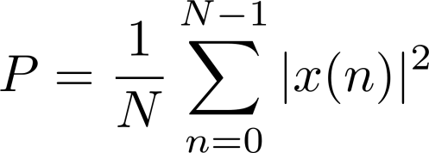
EITF75, Introduction
Some notation and basics
Some recap, notation and other basics
Energy of signal
Average power of signal

Slide 54
EITF75, Introduction
Some notation and basics
Some recap, notation and other basics
Energy of signal
Average power of signal
Ohm’s law:
Power of signal:

Slide 55
EITF75, Introduction
Some notation and basics
Some recap, notation and other basics
Energy of signal
Average power of signal
Ohm’s law:
Power of signal:
So:
One measures the voltage using some equipment. Said equipment has
a resistance, , which does not change when the voltage changes.
Therefore, the power of two signals can be fairly compared using the square law.

Slide 56
EITF75, Introduction
Some notation and basics
Some recap, notation and other basics
Energy of signal
Average power of signal
Even symmetry
Odd symmetry

Slide 57
EITF75, Introduction
Some notation and basics
Some recap, notation and other basics
Energy of signal
Average power of signal
Even symmetry
Odd symmetry
Finite Memory
depends on
system
but not on

Slide 58
EITF75, Introduction
Some notation and basics
Some recap, notation and other basics
Energy of signal
Average power of signal
Even symmetry
In words:
The output at time 10⁶
does not depend on the input at time 0
Odd symmetry
Finite Memory
depends on
system
but not on

Slide 59
EITF75, Introduction
Some notation and basics
Some recap, notation and other basics
Energy of signal
Average power of signal
Even symmetry
In words:
The output at time 10⁶
depends on the input at time 0
Odd symmetry
Finite Memory
Infinite Memory
depends on
depends on
but not on

Slide 60
EITF75, Introduction
Some notation and basics
Some recap, notation and other basics
Energy of signal
Average power of signal
Even symmetry
Odd symmetry
Finite Memory
Infinite Memory
depends on
depends on
but not on
We will study why later….

Slide 61
EITF75, Introduction
Some notation and basics
Some recap, notation and other basics
system
Linear system

Slide 62
EITF75, Introduction
Some notation and basics
Some recap, notation and other basics
system
Linear system
system
system
system

Slide 63
EITF75, Introduction
Some notation and basics
Some recap, notation and other basics
system
Linear system
Holds for all linear systems
system
system
system

Slide 64
EITF75, Introduction
Some notation and basics
Some recap, notation and other basics
system
Linear system
Time invariant system

Slide 65
EITF75, Introduction
Some notation and basics
Some recap, notation and other basics
system
Linear system
Time invariant system
system

Slide 66
EITF75, Introduction
Some notation and basics
Some recap, notation and other basics
system
Linear system
Time invariant system
system
system

Slide 67
EITF75, Introduction
Some notation and basics
Some recap, notation and other basics
system
Linear system
Time invariant system
BIBO-stability
BIBO = Bounded input,
bounded output

Slide 68
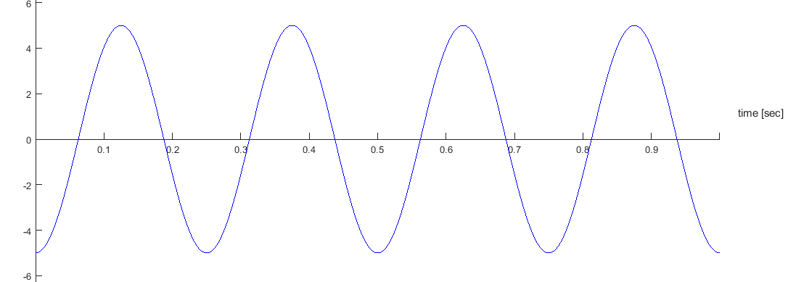
EITF75, Introduction
Some notation and basics
Preliminaries of Sinusoids
Amplitude
Frequency [Hz]
Phase [Rad]

Slide 69
EITF75, Introduction
Some notation and basics
Preliminaries of Sinusoids
Amplitude
Frequency [Hz]
Phase [Rad]
Period [s]

Slide 70
EITF75, Introduction
Some notation and basics
Preliminaries of Sinusoids
Amplitude
Frequency [Hz]
Phase [Rad]
Period [s]
Freq [Rad/s]

Slide 71
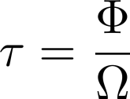
EITF75, Introduction
Some notation and basics
Preliminaries of Sinusoids
Amplitude
Frequency [Hz]
Phase [Rad]
Period [s]
Freq [Rad/s]
Delay [s]

Slide 72
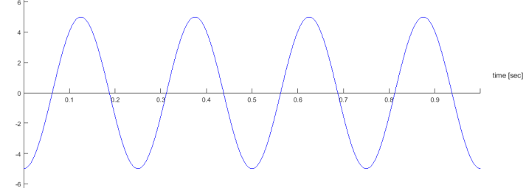
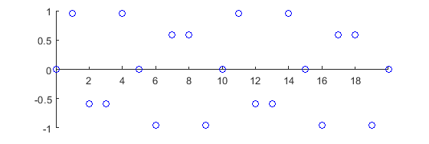
EITF75, Introduction
Some notation and basics
Preliminaries of Sinusoids
Digital Freq [-]

Slide 73
EITF75, Introduction
Some notation and basics
Preliminaries of Sinusoids
Digital Freq [-]

Slide 74
EITF75, Introduction
Some notation and basics
Preliminaries of Sinusoids
Digital Freq [-]
Digital Freq [-]

Slide 75
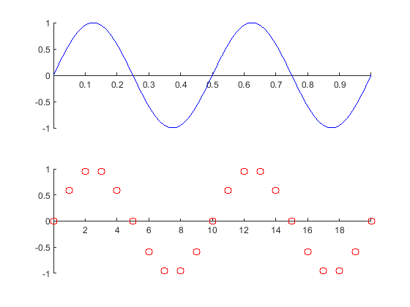
EITF75, Introduction
Some notation and basics
Preliminaries of Sinusoids
Examples

Slide 76
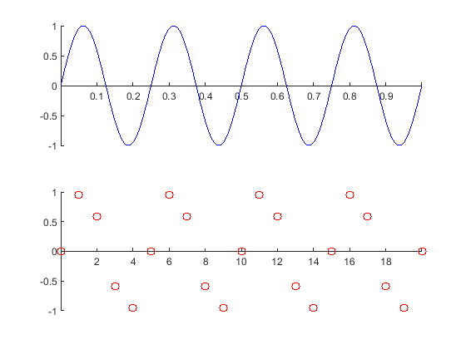
EITF75, Introduction
Some notation and basics
Preliminaries of Sinusoids
Examples

Slide 77
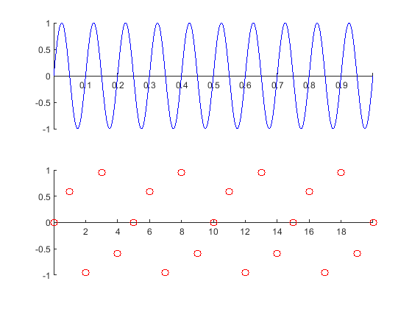
EITF75, Introduction
Some notation and basics
Preliminaries of Sinusoids
Examples

Slide 78
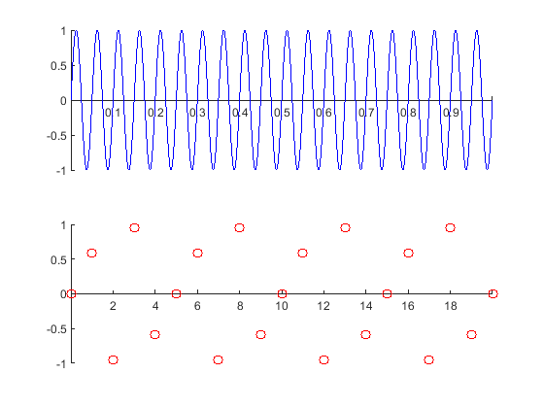
EITF75, Introduction
Some notation and basics
Preliminaries of Sinusoids
Examples
No change

Slide 79
EITF75, Introduction
Some notation and basics
Preliminaries of Sinusoids
Examples
No change

Slide 80
EITF75, Introduction
Some notation and basics
Preliminaries of Sinusoids
Explanation
No change

Slide 81
EITF75, Introduction
Some notation and basics
Preliminaries of Sinusoids
Explanation
No change

Slide 82
EITF75, Introduction
Some notation and basics
Preliminaries of Sinusoids
Explanation
No change

Slide 83
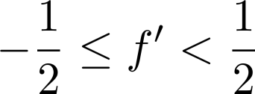
EITF75, Introduction
Some notation and basics
Preliminaries of Sinusoids
Important
Discrete sinusoid defined with a frequency
of at most ½ (or π rad) in magnitude
(Since higher frequencies than this don’t make any sense)
No change

Slide 84
EITF75, Introduction
Some notation and basics
Preliminaries of Sampling
sampling
RAM
Processing
Reconstruction
Sample with 1000 samples/sec

Slide 85
EITF75, Introduction
Some notation and basics
Preliminaries of Sampling
sampling
RAM
Processing
Reconstruction
symbol
meaning
Ex. value
Sample with 1000 samples/sec
# Samples/sec [Hz]
Time between samples [s]

Slide 86
EITF75, Introduction
Some notation and basics
Preliminaries of Sampling
sampling
RAM
Processing
Reconstruction
symbol
meaning
Ex. value
Sample with 1000 samples/sec
# Samples/sec [Hz]
Time between samples [s]

Slide 87
EITF75, Introduction
Some notation and basics
Preliminaries of Sampling
sampling
RAM
Processing
Reconstruction
symbol
meaning
Ex. value
Sample with 1000 samples/sec
# Samples/sec [Hz]
Time between samples [s]

Slide 88
EITF75, Introduction
Some notation and basics
Preliminaries of Sampling
sampling
RAM
Processing
Reconstruction
Sample with 1000 samples/sec
Sample with 1000 samples/sec

Slide 89
EITF75, Introduction
Some notation and basics
Preliminaries of Sampling
sampling
RAM
Processing
Reconstruction
Sample with 1000 samples/sec
Sample with 1000 samples/sec

Slide 90
EITF75, Introduction
Some notation and basics
Preliminaries of Sampling
sampling
RAM
Processing
Reconstruction
Sample with 1000 samples/sec
Sample with 1000 samples/sec
Sampling rate too low

Slide 91
EITF75, Introduction
Some notation and basics
Preliminaries of Sampling
sampling
RAM
Processing
Reconstruction
Conclusion (verify this at home)
If
and we want a sampling Frequency such that we can
reconstruct from , then must satisfy

Slide 92
EITF75, Introduction
Some notation and basics
Preliminaries of Sampling
sampling
RAM
Processing
Reconstruction
Conclusion (verify this at home)
If
and we want a sampling Frequency such that we can
reconstruct from , then must satisfy

