Slide 1
Multiuser Communications
Dimitrios vlastaras

Slide 2
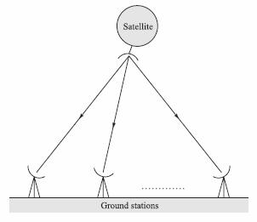
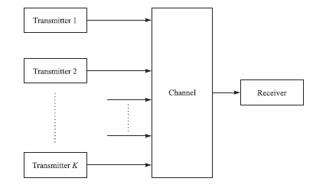
Introduction to Multiple Access Techniques
Different kinds of multiuser systems
One transmitter to many
Receivers (broadcast)
Many transmitters to one receiver

Slide 3
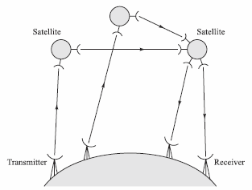
Introduction to Multiple Access Techniques
Two-way communication system
More kinds of multiuser systems
Store-and-forward network

Slide 4
Introduction to Multiple Access Techniques
How do we add multiple users?
Divide them in frequency (FDMA)
Divide them in time (TDMA)
But, what does that mean?
Problems with bursty access methods? Yes!
Periods of no transmission!
Therefore, FDMA and TDMA tend to be inefficient

Slide 5
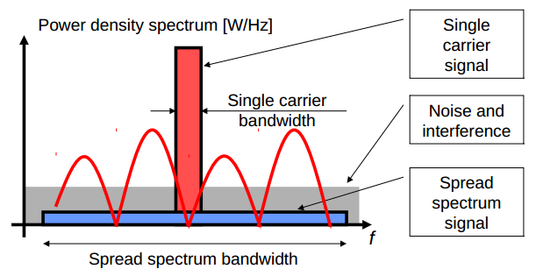
Introduction to Multiple Access Techniques
How do we solve FDMA and TDMA problems?
By use of Direct-sequence spread spectrum signals (DSSS)
Each user is assigned a unique code sequence (pref. orthogonal)
Separated at the receiver by cross correlation
Sequences must have small cross correlations to minimize crosstalk
Completely overlap in time and frequency
This multiple access method is called Code Division Multiple Access (CDMA)
Some times called Spread Spectrum Multiple Access (SSMA)

Slide 6
Introduction to Multiple Access Techniques
Alternative nonspread random access methods to CDMA
Transmissions collide
Loss of data
Protocols for retransmission

Slide 7
Capacity of Multiple Access Methods
Let’s refresh out memory about capacity
Ideal band-limited AWGN channel
$K$ users
Each user has an average power $P_{i}=P$ for $1≤i≤K$
$\frac{N_{0}}{2}$ is the PSD of the additive noise

Slide 8
Capacity of Multiple Access Methods
What about FDMA capacity?
In FDMA each user has bandwidth $\frac{W}{K}$, so capacity per user is
And the total capacity is
Therefore, the total capacity is the same as for a single
user with average power $P_{av}=KP$

Slide 9
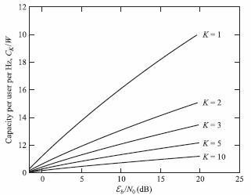
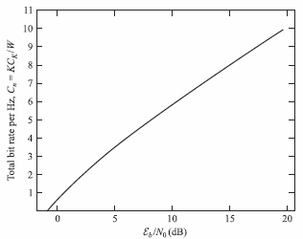
Capacity of Multiple Access Methods
Interesting fact: For a fixed $W$ the total capacity goes to infinity as
$K$ increases. However, each user is allocated a smaller bandwidth $\frac{W}{K}$
and the capacity per user decreases.
Normalized capacity as function of $\frac{ε_{b}}{N_{0}}$ for FDMA
Total capacity per hertz as a function of $\frac{ε_{b}}{N_{0}}$ for FDMA.
Given $C_{n}=K\frac{C_{k}}{W} :$

Slide 10
Capacity of Multiple Access Methods
What about TDMA capacity?
In TDMA each user transmits for $\frac{1}{K}$ through the channel of
bandwidth $W$ with average power $KP$. So, capacity per user is
Which is the same capacity as for an FDMA system. However, it may not be possible for the transmitters to sustain a power of $KP$ when $K$ is very large.

Slide 11
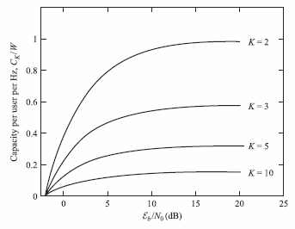
Capacity of Multiple Access Methods
What about CDMA capacity?
In CDMA each user transmits a pseudorandom signal of bandwidth $W$ and average power $P$. The capacity depends the level of cooperation among the $K$ users.
Noncooperative CDMA: Receiver for each user does not know the codes of the other users. So, capacity per user is
Or normalized
Normalized capacity as a function of $\frac{ε_{b}}{N_{0}}$ for
Noncooperative CDMA.

Slide 12
Capacity of Multiple Access Methods
What about CDMA capacity?
In CDMA each user transmits a pseudorandom signal of bandwidth $W$ and average power $P$. The capacity depends the level of cooperation among the $K$ users.
”Cooperative” CDMA: $K$ users cooperate by transmitting their coded signals synchronously in time. This is called multiuser detection and decoding. Each user is assigned a rate $R_{i}$, $1≤i≤K$, and a code book containing a set of $2_{}^{nR_{i}}$ codewords of power $P$. In each signal interval, each user selects an arbitrary codeword, say $X_{i}$, from its own code book, and all users transmit their codewords simultaneously.
Conclusion: Capacity similar to that of FDMA and TDMA.
Look in the book (p. 1034) for derivations!

Slide 13
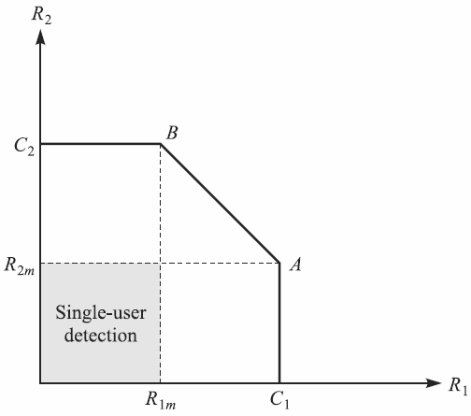
Capacity of Multiple Access Methods
Capacity region of two-user CDMA multiple
access Gaussian channel.

Slide 14
Multiuser Detection in CDMA Systems
CDMA Signal and Channel Models
The Optimum Multiuser Receiver (Exponentially growing complexity)
Suboptimum Detectors (Lower computational complexity)
Successive Interference Cancellation
Other Types of Multiuser Detectors
Performance Characteristics of Detectors

Slide 15
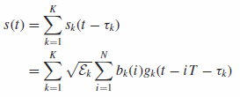
CDMA Signal and Channel Models
CDMA channel shared by $K$ simultaneous users
User signature waveform:
All $K$ signature waveforms have energy:
Cross correlations important metrics for detector performance:
Lowpass transmitted waveform where $\{b_{k}(m)\}$ is the information sequence of the $k^{\text{th}}$ user:
Composite transmitted signal for $K$ users where $\{τ_{k}\}$ are transmission delays:
The received signal assuming that the transmitted signal is corrupted by AWGN:

Slide 16
The Optimum Multiuser Receiver
The optimum (maximum-likelihood) receiver is the receiver that selects the most probable sequence of bits $\{b_{k}\left(n\right), 1≤n≤N, 1≤k≤K\}$ given the received signal $r(t)$ is observed over the time interval $0≤t≤NT+2T$.
Synchronous transmission Each user/interferer produces exactly one symbol which interferes with the desired symbol.
The received signal is
Compute the log-likelihood function
And select the sequence $\{b_{k}\left(1\right), 1≤k≤K\}$ that minimizes $Λ\left(b\right)$
Correlations

Slide 17
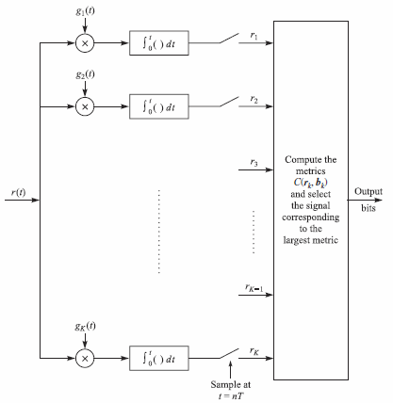
The Optimum Multiuser Receiver
The optimum (maximum-likelihood) receiver is the receiver that selects the most probable sequence of bits $\{b_{k}\left(n\right), 1≤n≤N, 1≤k≤K\}$ given the received signal $r(t)$ is observed over the time interval $0≤t≤NT+2T$.
Synchronous transmission

Slide 18
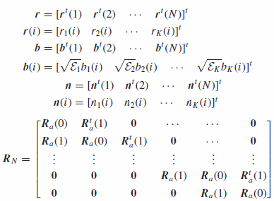
The Optimum Multiuser Receiver
The optimum (maximum-likelihood) receiver is the receiver that selects the most probable sequence of bits $\{b_{k}\left(n\right), 1≤n≤N, 1≤k≤K\}$ given the received signal $r(t)$ is observed over the time interval $0≤t≤NT+2T$.
Asynchronous transmission In this case, there are exactly two consecutive symbols from each interferer that overlap a desired symbol.
The log-likelihood function may be expressed in terms of a correlation metric where

Slide 19
The Optimum Multiuser Receiver
The optimum (maximum-likelihood) receiver is the receiver that selects the most probable sequence of bits $\{b_{k}\left(n\right), 1≤n≤N, 1≤k≤K\}$ given the received signal $r(t)$ is observed over the time interval $0≤t≤NT+2T$.
Asynchronous transmission In this case, there are exactly two consecutive symbols from each interferer that overlap a desired symbol.
The log-likelihood function may be expressed in terms of a correlation metric where
Y U SO COMPLEX?

Slide 20
The Optimum Multiuser Receiver
The optimum (maximum-likelihood) receiver is the receiver that selects the most probable sequence of bits $\{b_{k}\left(n\right), 1≤n≤N, 1≤k≤K\}$ given the received signal $r(t)$ is observed over the time interval $0≤t≤NT+2T$.
Block processing approach (Brute force)
Compute $2^{NK}$ correlation metrics
Sequence estimation employing the Viterbi algorithm
Feasible only when $K<10$
Use suboptimum detectors whose
complexity grows linearly with $K$!

Slide 21
Suboptimum Detectors
Suboptimum detectors have computational complexity that grown grows linearly with the number of users $K$, in comparison to the optimal multiuser receiver, whose complexity grows exponentially with $K$.

Slide 22
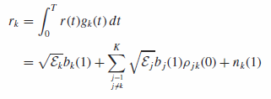
Suboptimum Detectors
Conventional single-user detector
In conventional single-user detection, the receiver consists of a demodulator that correlates (match-filters) the received signal with the signature sequence of the user and passes the output to the detector, which makes a decision.
It ignores other users and assumes the noise plus interference to be white and Gaussian. In synchronous transmissions, if the signature squences are orthogonal
The interference from other users given by the middle term vanishes.

Slide 23
Suboptimum Detectors
Conventional single-user detector
If one or more signature sequences are not orthogonal, the interference from other users can become excesive depending on the received signal energies.
This is called the near-far problem and necessitates some power of power control.
In asynchronous transmission, the conventional detector is more vulnerable to interference. This is because it is not possible to design signature sequences that are orthogonal.

Slide 24
Suboptimum Detectors
Decorrelating detector (ML)
It has linear computational complexity, like the conventional detector, but does not suffer from other user interference.
The results of the minimization of the likelihood function yields
Then the detected symbols are the sign of each element $b_{K}^{0}$

Slide 25
Suboptimum Detectors
Decorrelating detector (ML)
The transformation $R_{s}^{−1}$ eliminates the interference. Therefore the near-far problem is eliminated.
It is called the decorrelating detector since the received signal is correlated with modified signature waveforms. Thus, we have tuned out or decorrelated the multiuser interference.
For asynchronous transmission the minimization yields
Which is also a decorrelating detector, since $b^{0}$ in an unbiased estimate of $b$ and the multiuser interference has been eliminated.

Slide 26
Suboptimum Detectors
Minimum mean-square-error (MMSE) detector
Another solution is obtained if we seek the linear transformation $b^{0}=Ar$, where the matrix $A$ is to be determined so as to minimize the mean square error (MSE).
For synchronous communication
And asynchronous communication
where the output is again $\hat{b}=sgn(b^{0})$

Slide 27
Successive Interference Cancellation
Successive Interference Cancellation (SIC) is another multiuser detection technique. The interfering signal waveforms are removed one at a time as they are detected.
The user with the strongest received signal is demodulated and detected first. Then this information is used to substract the signal of the particular user from the received signal.
For synchronous transmission
Which is a suboptimum detector. The jointly optimum interference canceller may be defined as

Slide 28
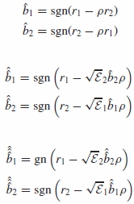
Successive Interference Cancellation
Multistage interference cancellation (MIC)
This is a technique that employs multiple iterations in detecting the user bits and cancelling the interference.
Example with two users and synchronous transmission:
First stage
(decorrelating detector):
Second stage:
Third stage:
Iterations stop when there is no change in the decisions. This is a suboptimum detector that does not converge to the jointly optimum multiuser detector.

Slide 29
Performance Characteristics of Detectors
Bit error probability is generally the desirable performance measure in multiuser communications.
The probability of a bit error for a single-user receiver for the optimum detector is extremely difficult to evaluate. We use the average probability between a lower and an upper bound.
For synchronous communications (p. 1050)
Also it is shown that

Slide 30
Performance Characteristics of Detectors
Bit error probability is generally the desirable performance measure in multiuser communications.
The probability of a bit error for a single-user receiver for the optimum detector is extremely difficult to evaluate. We use the average probability between a lower and an upper bound.
For asynchronous communications
Where $σ_{k}^{2}$ is the variance of the noise

Slide 31
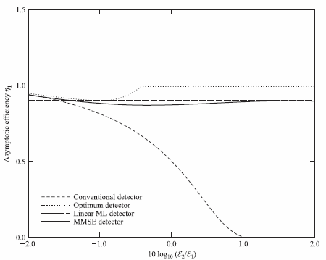
Performance Characteristics of Detectors
Asymptotic efficiency represents the performance loss due to multiuser interference.
Asymptotic efficiencies of optimum (Viterbi) detector, conventional detector, MMSE detector and linear ML detector in a two-user synchronous DS/SSMA system.

Slide 32
Multiuser MIMO Systems for Broadcast Channels
Linear Precoding of the Transmitted Signals
Nonlinear Vector Precoding
Precoding is a generalization of beamforming to support multi-stream (or multi-layer) transmission in multi-antenna wireless communications.

Slide 33
Linear Precoding of the Transmitted Signals
There are two linear precoders; one based on the zero-forcing and one on the MMSE criteria.
The communication system configuration is
Hence, the received signal vector is
where $H$ is the channel and $A_{T}$ is the precoding matrix.

Slide 34
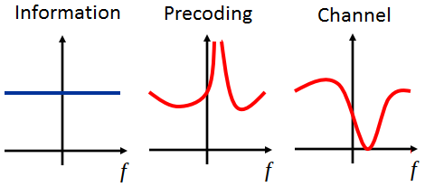
Linear Precoding of the Transmitted Signals
In zero-forcing the precoding matrix $A_{T}$ is set to the inverse of the channel $H^{−1}$.
However, the major drawback with zero-forcing is when the channel matrix $H$ is ill-conditioned. Then the power ${\left\|H^{−1}\right\|}^{2}≫1$.
Here
How do we solve this?

Slide 35
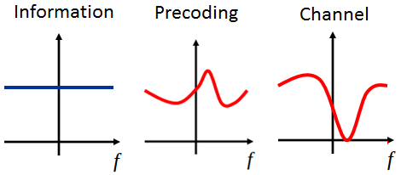
Linear Precoding of the Transmitted Signals
By using the linear MSE criterion!
Here the precoding matrix is selected as $A_{T}≈H^{−1}$ so that ${\left\|A_{T}\right\|}^{2}≪{\left\|H^{−1}\right\|}^{2}$.
Such a precoding matrix can be found by minimizing the cost function
The solution to the MMSE criterion is the precoding matrix
$${\left\|A_{T}\right\|}^{2}≪{\left\|H^{−1}\right\|}^{2}$$

Slide 36
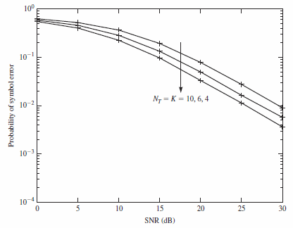
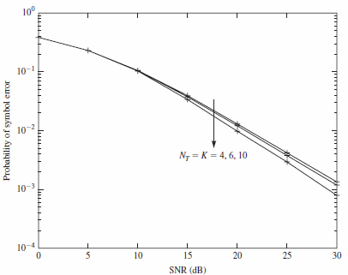
Linear Precoding of the Transmitted Signals
Performance of zero-forcing (left) vs MMSE (right) linear precodings with $N_{T}=K=4, 6, 10$. Probability of symbol error increases as the number of users $K$ increases (left) / decreases (right).

Slide 37
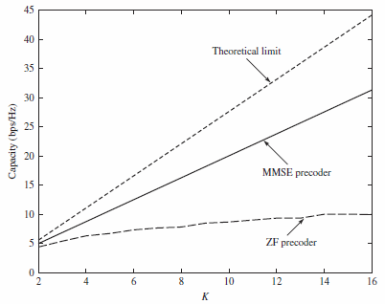
Linear Precoding of the Transmitted Signals
Comparison of the sum capacity for the linear precoder as a function of the number of users $K$ for an $SNR=10\text{dB}$.

Slide 38
Nonlinear Vector Precoding
We consider a modification of the zero-forcing precoder. Each element of the data vector $s$ is offset by some wisely chosen integer such as $s’=s+τ\hat{p}$, as seen in the figure below.
$τ$ is an integer selected so that it results in a symmetric decoding region around the real and imaginary components of every signal constellation symbol. Such a choice is
$$τ={2\left|s_{k}\right|}_{max}+Δ$$
where ${2\left|s_{k}\right|}_{max}$ is the signal contellation symbol with the largest magnitude and $Δ$ is the distance between adjacent symbols.

Slide 39
Nonlinear Vector Precoding
Now we select a vector $\hat{p}$ so that it minimizes the power in the transmitted signal
$\hat{p}=\arg{\min_{p}{{\left\|αH^{−1}\left(s+τp\right)\right\|}^{2}}}$
4PAM Example
Transmit ${x=H}^{−1}(s+8p)$
Receive $y=\left(s+8p\right)$
$s$ can now be obtained by $s=y mod 8$ since $p$ is a vector of integers.

