Slide 1
Chapter 6 Information Theory

Slide 2
6.1 Mathematical models for information source
Discrete source

Slide 3
6.1 Mathematical models for information source
Discrete memoryless source (DMS)
Source outputs are independent random variables
Discrete stationary source
Source outputs are statistically dependent
Stationary: joint probabilities of and
are identical for all shifts m
Characterized by joint PDF
Notes:
Model relatives to the probability, if everything is deterministic, no information is transmitted

Slide 4
6.2 Measure of information
Entropy of random variable X
A measure of uncertainty or ambiguity in X
A measure of information that is required by knowledge of X, or information content of X per symbol
Unit: bits (log_2) or nats (log_e) per symbol
We define
Entropy depends on probabilities of X, not values of X
Notes:
If information source is deterministic, for one value of X the probability equals 1, others equal 0, entropy of X is 0, contain no information

Slide 5
Shannon’s fundamental paper in 1948 “A Mathematical Theory of Communication”
Can we define a quantity which will measure how much information is “produced” by a process?
He wants this measure to satisfy:
H should be continuous in
If all are equal, H should be monotonically increasing with n
If a choice can be broken down into two successive choices, the original H should be the weighted sum of the individual values of H
Notes:
On 3), give example on board

Slide 6
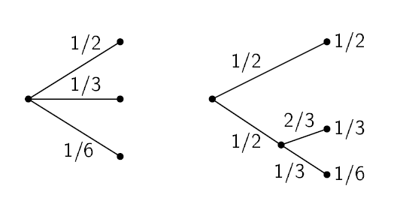
Shannon’s fundamental paper in 1948 “A Mathematical Theory of Communication”

Slide 7
Shannon’s fundamental paper in 1948 “A Mathematical Theory of Communication”
The only H satisfying the three assumptions is of the form:
K is a positive constant.

Slide 8
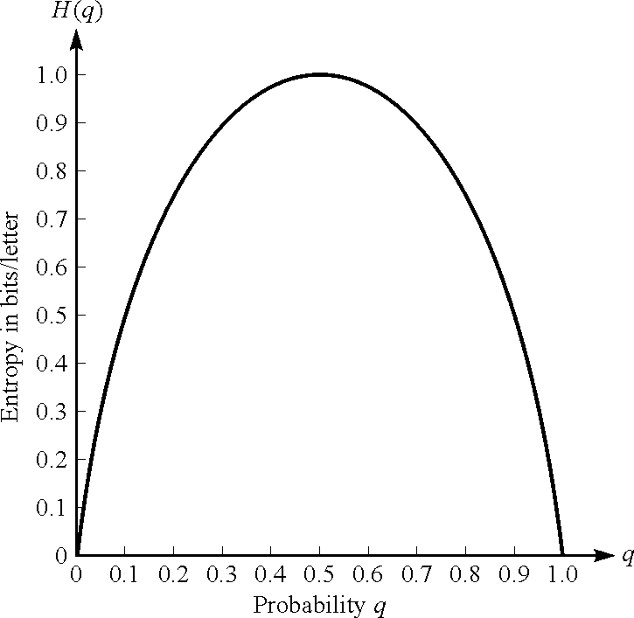
Binary entropy function
H(p)
H=0: no uncertainty
H=1: most uncertainty
1 bit for binary information
Probability p
Notes:
When equal probability, we reach the maximal – 1 bit information per symbol

Slide 9
Mutual information
Two discrete random variables: X and Y
Measures the information knowing either variables provides about the other
What if X and Y are fully independent or dependent?
Notes:
Fully independent: I=0, fully dependent I=H(X)=H(Y)

Slide 10
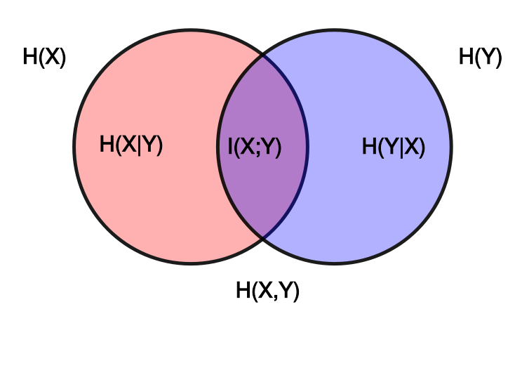
Notes:
Intuitively, if entropy H(X) is regarded as a measure of uncertainty about a random variable, then H(X|Y) is a measure of what Y does not say about X. This is "the amount of uncertainty remaining about X after Y is known",

Slide 11
Some properties
Entropy is maximized
when probabilities are equal

Slide 12
Joint and conditional entropy
Joint entropy
Conditional entropy of Y given X

Slide 13
Joint and conditional entropy
Chain rule for entropies
Therefore,
If X_{i} are iid

Slide 14
6.3 Lossless coding of information source
Source sequence with length n
n is assumed to be large
Without any source coding
we need bits per symbol

Slide 15
Lossless source coding
Typical sequence
Number of occurrence of is roughly
When , any will be “typical”
All typical sequences have the same probability

Slide 16
Lossless source coding
Typical sequence
Since typical sequences are almost certain to occur, for the source output it is sufficient to consider only these typical sequences
How many bits per symbol we need now?
Number of typical sequences =

Slide 17
Lossless source coding
Shannon’s First Theorem - Lossless Source Coding
Let X denote a discrete memoryless source. There exists a lossless source code at rate R if
bits per transmission
Notes:
This gives a fundamental limits on source coding. And entropy plays an important role in lossless compression of information source

Slide 18
Lossless source coding
For discrete stationary source…

Slide 19
Lossless source coding algorithms
Variable-length coding algorithm
Symbols with higher probability are assigned shorter code words
E.g. Huffman coding
Fixed-length coding algorithm
E.g. Lempel-Ziv coding

Slide 20
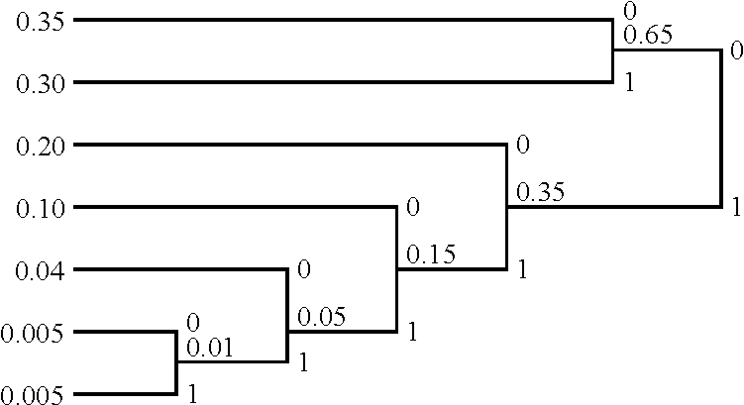
Huffman coding algorithm
P(x₁)
P(x₂)
P(x₃)
P(x₄)
P(x₅)
x₁ | 00
x₂ | 01
x₃ | 10
x₄ | 110
x₅ | 1110
x₆ | 11110
x₇ | 11111
P(x₆)
P(x₇)
H(X)=2.11
R=2.21 bits per symbol
Notes:
Huffman coding is optimum is a sense that the average number of bits presents source symbol is a minimum, subject to that the code words satisfy the prefix condition

Slide 21
6.5 Channel models and channel capacity
Channel models
input sequence
output sequence
A channel is memoryless if
Notes:
Channel models are useful when we design codes

Slide 22
Binary symmetric channel (BSC) model
Source data
Output data
Channel encoder
Binary modulator
Channel
Demodulator and detector
Channel decoder
Composite discrete-input discrete output channel

Slide 23
Binary symmetric channel (BSC) model
1-p
0
0
p
Input
Output
p
1
1
1-p

Slide 24
Discrete memoryless channel (DMC)
{X}
{Y}
Input
x₀
y₀
Output
x₁
y₁
…
…
…
x_{M-1}
can be arranged in a matrix
y_{Q-1}
Notes:
A more general case of BSC. M-ary modulation

Slide 25
Discrete-input continuous-output channel
If N is additive white Gaussian noise…
Notes:
Output of detector is unquantized. Probability density function…

Slide 26
Discrete-time AWGN channel
Power constraint
For input sequence with large n

Slide 27
AWGN waveform channel
Assume channel has bandwidth W, with frequency response C(f)=1, [-W, +W]
Source data
Output data
Channel encoder
Modulator
Physical channel
Demodulator and detector
Channel decoder
Input waveform
Output waveform

Slide 28
AWGN waveform channel
Power constraint

Slide 29
AWGN waveform channel
How to define probabilities that characterize the channel?
Equivalent to 2W uses per second of a discrete-time channel
Notes:
We can use the coefficients to characterize the channel...

Slide 30
AWGN waveform channel
Power constraint becomes...
Hence,

Slide 31
Channel capacity
After source coding, we have binary sequency of length n
Channel causes probability of bit error p
When n->inf, the number of sequences that have np errors

Slide 32
Channel capacity
To reduce errors, we use a subset of all possible sequences
Information rate [bits per transmission]
Capacity of
binary channel

Slide 33
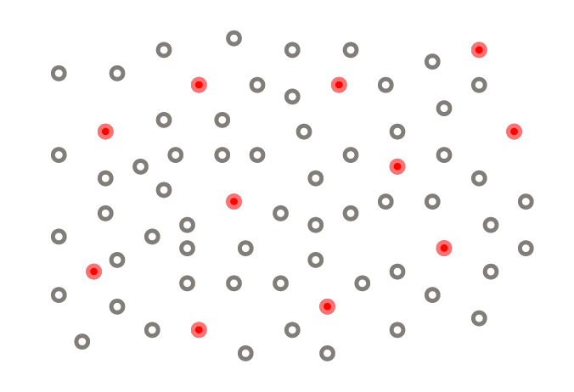
Channel capacity
We cannot transmit more than 1 bit per channel use
Channel encoder: add redundancy
2^{n} different binary sequencies of length n contain information
We use 2^{m} different binary sequencies of length m for transmission

Slide 34
Channel capacity
Capacity for abitray discrete memoryless channel
Maximize mutual information between input and output, over all
Shannon’s Second Theorem – noisy channel coding
R < C, reliable communication is possible
R > C, reliable communication is impossible

Slide 35
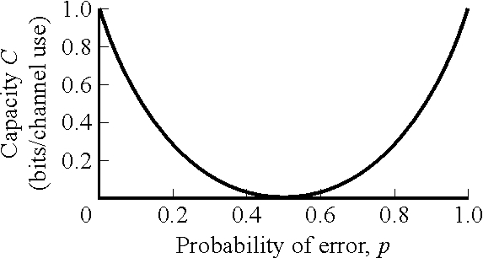
Channel capacity
For binary symmetric channel
Notes:
symmetric

Slide 36
Channel capacity
Discrete-time AWGN channel with an input power constraint
For large n,

Slide 37
Channel capacity
Discrete-time AWGN channel with an input power constraint
Maximum number of symbols to transmit
Transmission rate
Can be obtained by directly maximizing I(X;Y), subject to power constraint

Slide 38
Channel capacity
Band-limited waveform AWGN channel with input power constraint
- Equivalent to 2W use per second of discrete-time channel
bits/channel use
bits/s

Slide 39
Channel capacity

Slide 40
Channel capacity
Bandwidth efficiency
Relation of bandwidth efficiency and power efficiency
Notes:
Minimum snr required for any communication system

Slide 41
