Slide 1
Digital Communications Fredrik Rusek
Chapter 10,
adaptive equalization and more
Proakis-Salehi

Slide 2
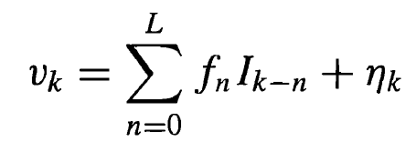
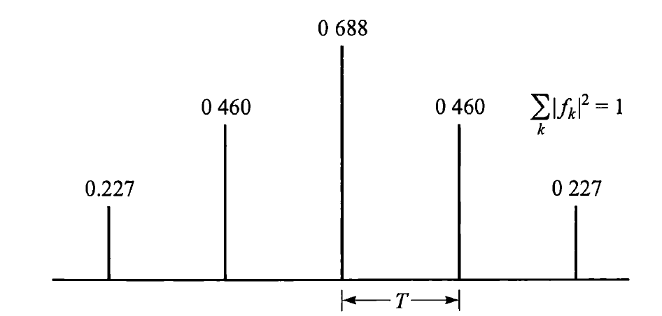
Brief review of equalizers
Channel model is
Where f_{n} is a causal white ISI sequence, for example the C-channel, and the noise is white

Slide 3
Brief review of equalizers
Let us take a look on how to create f_{n} again
Add noise
Where is f_{n} ?

Slide 4
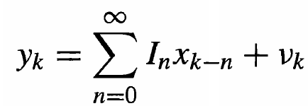
Brief review of equalizers
Let us take a look on how to create f_{n} again
Add noise
Optimal receiver front-end is a matched filter

Slide 5
Brief review of equalizers
Let us take a look on how to create f_{n} again
Add noise
Optimal receiver front-end is a matched filter
What is the statistics of x_{k} and v_{k} ?

Slide 6
Brief review of equalizers
Let us take a look on how to create f_{n} again
Add noise
Optimal receiver front-end is a matched filter
What is the statistics of x_{k} and v_{k} ?
X_{k} has Hermitian symmetry
Cov[v_{k}v*_{k+l}]=x_{l}
x_{k} is not causal, noise is not white!

Slide 7
Brief review of equalizers
Let us take a look on how to create f_{n} again
Add noise
Noise whitening strategy 1
Noise whitener
The noise whitener is using the fact that the noise has x_{k} as covariance
f_{k} is now causal and the noise is white

Slide 8
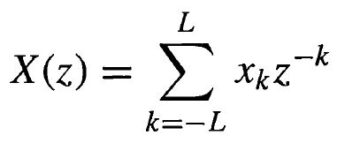
Brief review of equalizers
Noise whitening with more detail
Define
Then
Choosing the whitener as will yield a channel according to
The noise covariance will be flat (independent of F(z)) because of the following identity

Slide 9
Brief review of equalizers
Noise whitening strategy 2. Important.
In practice, one seldomly sees the matched filter followed by the whitener.
Hardware implementation of MF is fixed, and cannot depend on the channel
How to build the front-end?
Desires:
Should be optimal
Should generate white noise at output

Slide 10
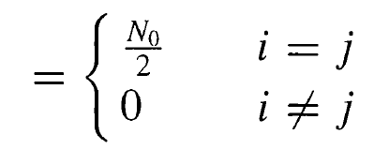
Brief review of equalizers
From Eq (4.2-11), we know that if the front end creates is an orthonormal basis, then the noise is white

Slide 11
Brief review of equalizers
From Eq (4.2-11), we know that if the front end creates is an orthonormal basis, then the noise is white
We must therefore choose the front-end, call it z(t), such that
$$\int_{−∞}^{∞}{z\left(t\right)z^{∗}\left(t−kT\right)dt=δ_{k}}$$
Each pulse z(t-kT) now constitutes one dimension φ_{k}(t)
The root-RC pulses from the last lecture works well

Slide 12
Brief review of equalizers
Noise whitening strategy 2. Important.
In practice, one seldomly sees the matched filter followed by the whitener.
Hardware implementation of MF is fixed, and cannot depend on the channel
How to build the front-end?
Desires:
Should be optimal
Should generate white noise at output OK!
But how to guarantee optimality?

Slide 13
Brief review of equalizers
Fourier transform of received pulse
H(f)
This is bandlimited since the transmit pulse g(t) is bandlimited

Slide 14
Brief review of equalizers
Choose Z(f) as
H(f)
In this way z(t) creates a complete basis for h(t) and generates white noise at the same time
LTE and other practical systems are choosing a front-end such that
Noise is white
Signal of interest can be fully described

Slide 15
Brief review of equalizers
Add noise
Optimal receiver front-end is a matched filter

Slide 16
Brief review of equalizers
Add noise
Receiver front-end is a constant and not dependent on the channel at all.
Z(f)

Slide 17
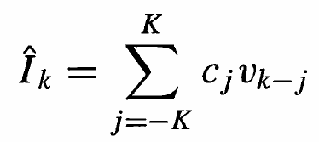
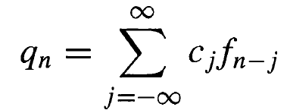
Brief review of equalizers
Linear equalizers.
Problem formulation: Given apply a linear filter to get back the data I_{n}
With
We get

Slide 18
Brief review of equalizers
Linear equalizers.
Problem formulation: Given apply a linear filter to get back the data I_{n}
With
We get
Zero-forcing
MMSE
min

Slide 19
Brief review of equalizers
Non-linear DFE.
Problem formulation: Given apply a linear filter to get back the data I_{k}
Previously detected symbols
DFE - MMSE
min

Slide 20
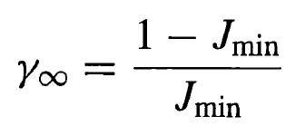
Brief review of equalizers
Comparisons
Output SNR of ZF
Error (J) of MMSE
Error (J) of DFE-MMSE

Slide 21
Tomlinson-Harashima precoding (related to dirty-paper-coding)
Assume MPAM (-(M-1),…(M-1)) transmission, and the simple channel model y=x+n
Assume that there is a disturbance at the channel
y=x+n+pM, p an integer
The reciver can remove the disturbance by mod(y,M)=mod(x+n+pM,M)=x+w,
Where w has a complicated distribution. However, w=n, if n is small.

Slide 22
Tomlinson-Harashima precoding (related to dirty-paper-coding)
Assume MPAM (-(M-1),…(M-1)) transmission, and the simple channel model y=x+n
Assume that there is a disturbance at the channel
y=x+n+pM, p an integer
The reciver can remove the disturbance by mod(y,M)=mod(x+n+pM,M)=x+w,
Where w has a complicated distribution. However, w=n, if n is small.
-3
3
M (=4)
Let the be x+n (i.e., received signal without any disturbance

Slide 23
Tomlinson-Harashima precoding (related to dirty-paper-coding)
Assume MPAM (-(M-1),…(M-1)) transmission, and the simple channel model y=x+n
Assume that there is a disturbance at the channel
y=x+n+pM, p an integer
The reciver can remove the disturbance by mod(y,M)=mod(x+n+pM,M)=x+w,
Where w has a complicated distribution. However, w=n, if n is small.
Add the disturbance
-3
3
-3+4p
3+4p
M (=4)
Let the be x+n (i.e., received signal without any disturbance

Slide 24
Tomlinson-Harashima precoding (related to dirty-paper-coding)
Assume MPAM (-(M-1),…(M-1)) transmission, and the simple channel model y=x+n
Assume that there is a disturbance at the channel
y=x+n+pM, p an integer
The reciver can remove the disturbance by mod(y,M)=mod(x+n+pM,M)=x+w,
Where w has a complicated distribution. However, w=n, if n is small.
-3
3
-3+4p
3+4p
M (=4)
Nothing changed, i.e., w=n
Now compute mod( ,4)

Slide 25
Tomlinson-Harashima precoding (related to dirty-paper-coding)
Assume MPAM (-(M-1),…(M-1)) transmission, and the simple channel model y=x+n
Assume that there is a disturbance at the channel
y=x+n+pM, p an integer
The reciver can remove the disturbance by mod(y,M)=mod(x+n+pM,M)=x+w,
Where w has a complicated distribution. However, w=n, if n is small.
-3
3
M (=4)
But, in this case we have a difference

Slide 26
Tomlinson-Harashima precoding (related to dirty-paper-coding)
Assume MPAM (-(M-1),…(M-1)) transmission, and the simple channel model y=x+n
Assume that there is a disturbance at the channel
y=x+n+pM, p an integer
The reciver can remove the disturbance by mod(y,M)=mod(x+n+pM,M)=x+w,
Where w has a complicated distribution. However, w=n, if n is small.
Add the disturbance
-3
3
-3+4p
3+4p
M (=4)

Slide 27
Tomlinson-Harashima precoding (related to dirty-paper-coding)
Assume MPAM (-(M-1),…(M-1)) transmission, and the simple channel model y=x+n
Assume that there is a disturbance at the channel
y=x+n+pM, p an integer
The reciver can remove the disturbance by mod(y,M)=mod(x+n+pM,M)=x+w,
Where w has a complicated distribution. However, w=n, if n is small.
-3
3
-3+4p
3+4p
M (=4)
Will be wrongly decoded, seldomly happens at high SNR though
Now compute mod( ,4)

Slide 28
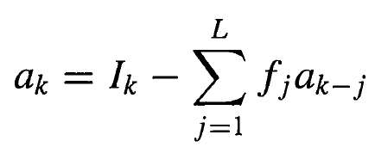
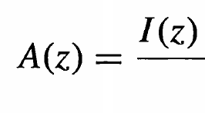
Tomlinson-Harashima precoding (related to dirty-paper-coding)
How does this fit in with ISI equalization?
Suppose we want to transmit I_{k} but that we apply precoding and transmits a_{k}
Or in terms of z-transforms
Meaning of this is that ISI is pre-cancelled at the transmitter
Since channel response is F(z), all ISI is gone

Slide 29
Tomlinson-Harashima precoding (related to dirty-paper-coding)
How does this fit in with ISI equalization?
Suppose we want to transmit I_{k} but that we apply precoding and transmits a_{k}
Or in terms of z-transforms
Meaning of this is that ISI is pre-cancelled at the transmitter
Problem is that if F(z) is small at some z, the transmitted energy is big
(this is the same problem as with ZF-equalizers)

Slide 30
Tomlinson-Harashima precoding (related to dirty-paper-coding)
How does this fit in with ISI equalization?
Suppose we want to transmit I_{k} but that we apply precoding and transmits a_{k}
Or in terms of z-transforms
Meaning of this is that ISI is pre-cancelled at the transmitter
If A(z) is big, it means that the a_{k} are also very big
Problem is that if F(z) is small at some z, the transmitted energy is big
(this is the same problem as with ZF-equalizers)

Slide 31
Tomlinson-Harashima precoding (related to dirty-paper-coding)
How does this fit in with ISI equalization?
Suppose we want to transmit I_{k} but that we apply precoding and transmits a_{k}
Or in terms of z-transforms
Add a disturbance that reduces the amplitude of a_{k}. b_{k} is chosen as an integer that minimizes the amplitude of a_{k}

Slide 32
Tomlinson-Harashima precoding (related to dirty-paper-coding)
How does this fit in with ISI equalization?
Suppose we want to transmit I_{k} but that we apply precoding and transmits a_{k}
Or in terms of z-transforms
Add a disturbance that reduces the amplitude of a_{k}. b_{k} is chosen as an integer that minimizes the amplitude of a_{k}

Slide 33
Tomlinson-Harashima precoding (related to dirty-paper-coding)
How does this fit in with ISI equalization?
Suppose we want to transmit I_{k} but that we apply precoding and transmits a_{k}
Or in terms of z-transforms
Add a disturbance that reduces the amplitude of a_{k}. b_{k} is chosen as an integer that minimizes the amplitude of a_{k}
Channel ”removes” F(z), modulus operation ”removes” 2MB(z)

Slide 34
Chapter 10

Slide 35
Objectives
So far, we only considered the case where the channel f_{n} was known in advance
Now we consider the case when the channel is unknown, but a training block of known data symbols are present
We aim at establishing low-complexity adaptive methods for finding the optimal equalizer filters
This chapter has many applications outside of digital communications

Slide 36
10.1-1: Zero-forcing
We consider a ZF-equalizer with 2K+1 taps
With finite length, we cannot create
since we do not have enough DoFs
Instead (see book), we try to achieve
How to achieve this?

Slide 37
10.1-1: Zero-forcing
We consider a ZF-equalizer with 2K+1 taps
With finite length, we cannot create
since we do not have enough DoFs
Instead (see book), we try to achieve
How to achieve this? Consider

Slide 38
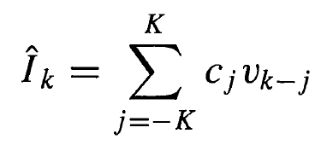
10.1-1: Zero-forcing
We consider a ZF-equalizer with 2K+1 taps
With finite length, we cannot create
since we do not have enough DoFs
Instead (see book), we try to achieve
How to achieve this?

Slide 39
10.1-1: Zero-forcing
We consider a ZF-equalizer with 2K+1 taps
With finite length, we cannot create
since we do not have enough DoFs
Instead (see book), we try to achieve
How to achieve this?
For
We get

Slide 40
10.1-1: Zero-forcing
Let be the j-th tap of the equalizer at time t=kT.
A simple recursive algorithm for adjusting these is
is a small stepsize
is an estimate of
For
We get

Slide 41
10.1-1: Zero-forcing
Let be the j-th tap of the equalizer at time t=kT.
A simple recursive algorithm for adjusting these is
Initial phase. Training present
is a small stepsize
is an estimate of
The above is done during the training phase. Once the training phase is complete, the equlizer has converged to some sufficiently good solution, so that the detected symbols can be used. This is the tracking phase (no known data symbols are inserted).
Tracking phase. No training present.
This can catch variations in the channel

Slide 42
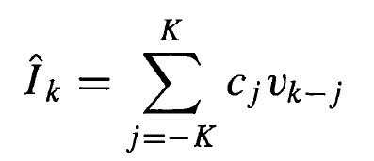
10.1-2: MMSE. The LMS algorithm
Again, we have a 2K+1 tap equalizer to adaptively solve for
Expanding J(K) gives
$$J\left(K\right)=1−E({{2re(I}_{k}}^{∗}vc))+c^{∗}E(v^{∗}v)c$$
Where c is a column vector of equalizer taps (to solve for)
and v is the vector of observed signals.
It turns out that
E(v*v)=
E(I_{k}*v)=
(2K+1)x(2K+1) matrix
T
(2K+1) vector

Slide 43
10.1-2: MMSE. The LMS algorithm
Using this, we get
J(K)=1 – 2Re(ξ*c)+c*Γc
$$J\left(K\right)=1−E({{2re(I}_{k}}^{∗}vc))+c^{∗}E(v^{∗}v)c$$
Where c is a column vector of equalizer taps (to solve for)
and v is the vector of observed signals.
It turns out that
E(v*v)=
E(I_{k}*v)=
Set gradient to 0
$\frac{δJ(K)}{δc}=−2\text{ξ}+2\text{Γ}\text{c}\text{=0}$
$c_{opt}={\text{Γ}}^{ −1}\text{ξ}\text{ , }J_{min}\left(K\right)=1−$ξ* ${\text{Γ}}^{ −1}$ξ
(2K+1)x(2K+1) matrix
T
(2K+1) vector

Slide 44
10.1-2: MMSE. The LMS algorithm
Using this, we get
J(K)=1 – 2Re(ξ*c)+c*Γc
Now, we would like to reach this solution without the matrix inversion.
In general, we would like to have a recursive way to compute it
Set gradient to 0
$\frac{δJ(K)}{δc}=−2\text{ξ}+2\text{Γ}\text{c}\text{=0}$
$c_{opt}={\text{Γ}}^{ −1}\text{ξ}\text{ , }J_{min}\left(K\right)=1−$ξ* ${\text{Γ}}^{ −1}$ξ

Slide 45
10.1-2: MMSE. The LMS algorithm
We can formulate the following recursive algorithm

Slide 46
10.1-2: MMSE. The LMS algorithm
We can formulate the following recursive algorithm
Equalizer at time t=kT
Small stepsize (more about this later)
Gradient vector
Vector of received symbols

Slide 47
10.1-2: MMSE. The LMS algorithm
We can formulate the following recursive algorithm
Whenever G_{k} = 0, the gradient is 0 and the optimal point is reached (since J(K) is quadratic and therefore any stationary point is a global optimum)

Slide 48
10.1-2: MMSE. The LMS algorithm
We can formulate the following recursive algorithm
Basic problem: The gradient depends on Γ and ξ , which are unknown (depends on channel)
As a remedy, we use estimates

Slide 49
10.1-2: MMSE. The LMS algorithm
We can formulate the following recursive algorithm
Basic problem: The gradient depends on Γ and ξ , which are unknown (depends on channel)
As a remedy, we use estimates
The estimator of the gradient is unbiased

Slide 50
10.1-2: MMSE. The LMS algorithm
We can formulate the following recursive algorithm
Basic problem: The gradient depends on Γ and ξ , which are unknown (depends on channel)
As a remedy, we use estimates
LMS algorithm (very famous)
The estimator of the gradient is unbiased

Slide 51
10.1-2: MMSE. The LMS algorithm
LMS algorithm (very famous)
This algorithm was so far assuming that known training symbols are present.
After the training period, the detected symbols are used to estimate the error ε_{k.} This tracks changes in the channel

Slide 52
10.1-3: Convergence of LMS algorithm
Assume correct gradient information, i.e.,
How fast does the algorithm converge?

Slide 53
10.1-3: Convergence of LMS algorithm
Assume correct gradient information, i.e.,
How fast does the algorithm converge?
Eigenvalue decomposition

Slide 54
10.1-3: Convergence of LMS algorithm
Assume correct gradient information, i.e.,
How fast does the algorithm converge?
Eigenvalue decomposition

Slide 55
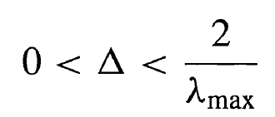
10.1-3: Convergence of LMS algorithm
To study convergence, it is sufficient to study the homogenous equation
This will converge provided that
Which is guaranteed if

Slide 56
10.1-3: Convergence of LMS algorithm
To study convergence, it is sufficient to study the homogenous equation
This will converge provided that
Which is guaranteed if
However, convergence is fast if 1-Δλ_{k} is very small.
For a small λ_{k} , this needs a big Δ, but this is not possible if λ_{max} is big
Hence, the ratio λ_{max} / λ_{min} determines the convergence speed

Slide 57
10.1-3: Convergence of LMS algorithm
Now, what is λ_{max} / λ_{min} physically meaning?
Recall that λ are the eigenvalues of the matrix Γ
But Γ is defined as
Very useful result (Spectral theorem, derived from Szegö’s theorem)
The eigenvalues of Γ converges for large K to the spectrum ${\left|H(w)\right|}^{2}$

Slide 58
10.1-3: Convergence of LMS algorithm
Now, what is λ_{max} / λ_{min} physically meaning?
Recall that λ are the eigenvalues of the matrix Γ
But Γ is defined as
Very useful result (Spectral theorem, derived from Szegö’s theorem)
The eigenvalues of Γ converges for large K to the spectrum ${\left|H(w)\right|}^{2}$
λ_{max}
λ_{min}
The worse the channel, the slower the convergence of the LMS
π

Slide 59
10.1-4: Convergence of LMS algorithm
The convergence analysis was made for perfect gradients, not for the estimates we must actually use
The impact of this is studied in the book
We can reduce the effect of the noisy gradients by using a small stepsize, but convergence is slower in that case

Slide 60
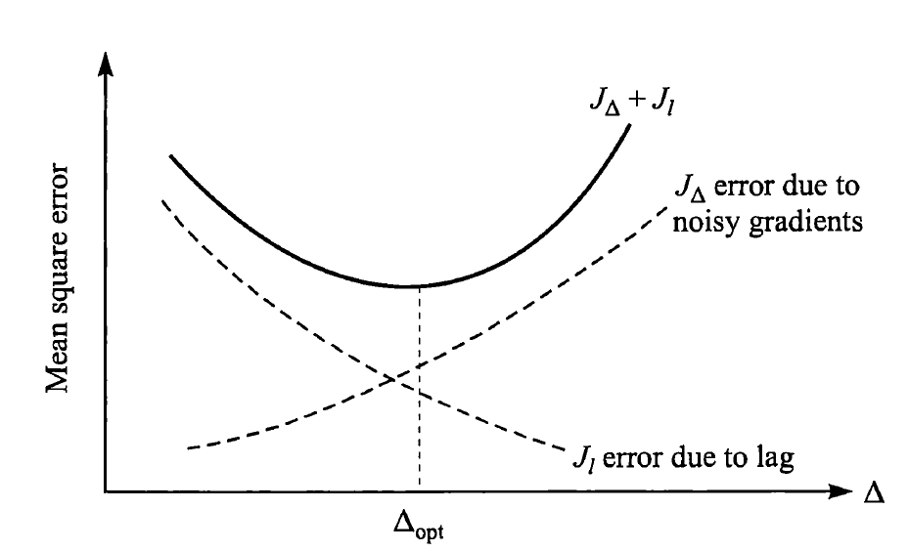
10.1-5: Convergence of LMS algorithm
The convergence analysis was made for noisy gradients, but not for changing channels
The impact of this is briefly studied in the book
With a small stepsize, one is protected from noisy gradients, but we cannot catch the changes of the channel.
There is a tradeoff
We can reduce the effect of the noisy gradients by using a small stepsize, but convergence is slower in that case
We can reduce the effect of a changing channel by using a larger stepsize

Slide 61
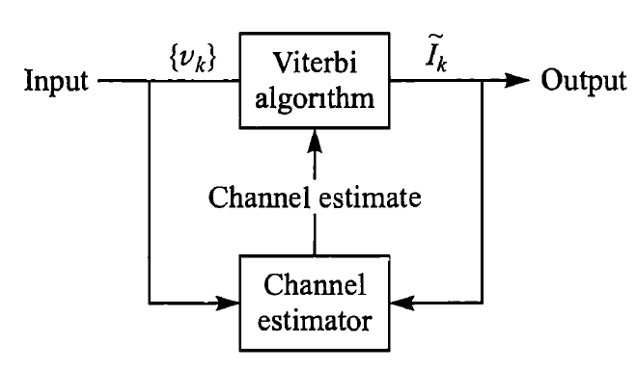
10.1-7: Convergence of LMS algorithm
Seldomly used concept, but with potential

Slide 62
Section 10.4. RLS algorithm (Kalman)
The problem of LMS is that there is only a single design parameter, namely the stepsize. Still, we have 2K+1 taps to optimize
RLS leverages this and uses 2K+1 design parameters.
Convergence is extremely fast, at the price of high computational complexity

Slide 63
Section 10.4. RLS algorithm (Kalman)
Optimization criterion
t is number of signals to use in time
w<1 is forgetting factor
C_{N}(t) is vector of equalizer taps at time t.
Y_{N}(n) is received signal at time n
N is number of length of equalizer
transpose
Each term e(n,t) measures how well the equalizer C(t) fits to the observation Y(n)
As the channel may change between n and t, there is exponential weightening through w
Notation in this section is very messy
Note: There is no expectation as in LMS!!

Slide 64
Section 10.4. RLS algorithm (Kalman)
Optimization of

Slide 65
Section 10.4. RLS algorithm (Kalman)
Optimization of
If we did this at some time t-1, and then move to time t, it is inefficient to start all over.
In RLS, the idea is to simply update C(t-1) with the new observation Y(t)

Slide 66
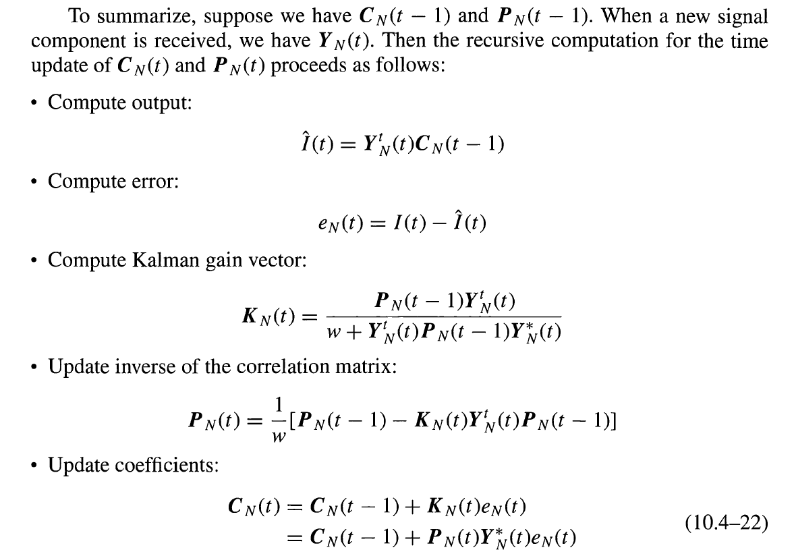
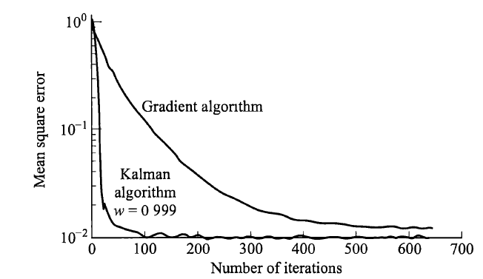
Section 10.4. RLS algorithm (Kalman)
See book for more details (very long derivations, standard Kalman derivations though)
Use demodulated value for I(n) in tracking phase
Complexity bottleneck

Slide 67
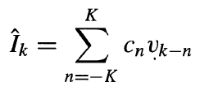
Section 10.5-2: No training available the Godard Algorithm
The task here is to blindly find an equalizer without any help from a training signal.
Suppose that c_{n} was perfect, so that ${\hat{I}}_{k}=I_{k}.$How would we know this?
We cannot look at the expectation of $E({\hat{I}}_{k})$ because this is always 0
We cannot look at the variance $E\left({|\hat{I}}_{k}|^{2}\right)$, because this is always 1

Slide 68
Section 10.5-2: No training available the Godard Algorithm
The task here is to blindly find an equalizer without any help from a training signal.
Suppose that c_{n} was perfect, so that ${\hat{I}}_{k}=I_{k}.$How would we know this?
We cannot look at the expectation of $E({\hat{I}}_{k})$ because this is always 0
We cannot look at the variance $E\left({|\hat{I}}_{k}|^{2}\right)$, because this is always 1
The idea is to make use of higher order statistics.

Slide 69
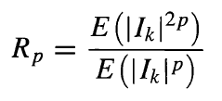
Section 10.5-2: No training available the Godard Algorithm
Let us define the following cost function, where R_{p} is a constant that depends on the constellation
For a given PAM constellation, the value of R_{p} can be selected in such a way that D^{(p)}
Is minimized if the equalizer outputs are correct
We can take the differential with respect to c_{k}
Optimum selection

Slide 70
Section 10.5-2: No training available the Godard Algorithm
More intuition…
Given the received signal, taking its expection and variance provides no information about the channel vector f
However, HoM does.
For example, the 4th cumulant of the received signal is
We know that
So we can get the channel vector from the cumulant directly as

